Slide 1
Introduction to OpenMP

Slide 2
Working Environment
Linux Environment (or)
Linux Terminal in Windows Environment
  MobaXTerm
    Download and install in your windows system

Slide 3
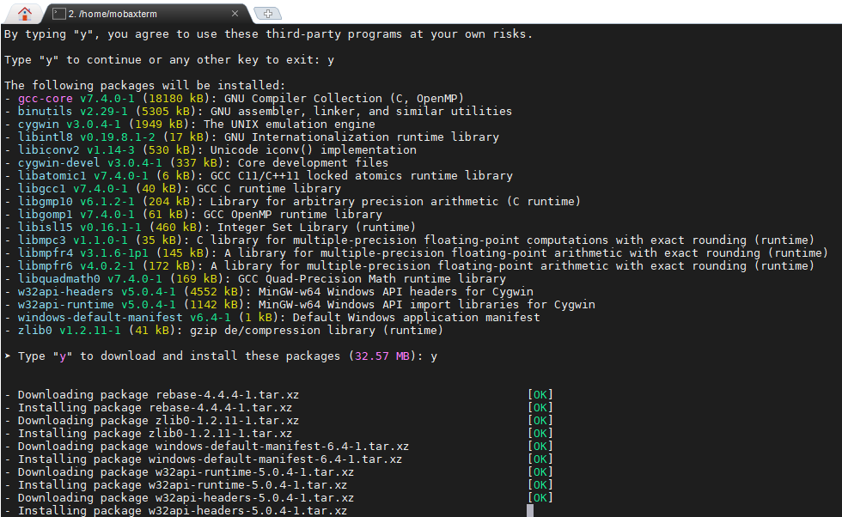
Install gcc in MobaXTerm
apt-get install gcc-core

Slide 4
OpenMP
The collection of compiler directives,
library routines, and environment
variables described in this document
collectively define the specification of the
OpenMP Application Program Interface
(OpenMP API) for shared-memory parallelism
in C, C++ and Fortran programs

Slide 5
Learning for today
Environment variables
  OMP_NUM_THREAD
Runtime library
  omp_get_num_thread()
  sched_getcpu()
Parallel Construct
Worksharing Construct
  for
  section

Slide 6
Simple OpenMP Programs

Slide 7
C Directive for OpenMP
Pragma
  #pragma omp construct
  #include<omp.h>
  Main()
  {
  ---
  #pragma omp parallel

Slide 8
Constructs
Parallel
Work-sharing
  for directive
  sections directive
  single directive
  parallel work-sharing
    parallel for
    parallel sections
Task
Synchronization
  Master directive
  Critical
  Barrier
  Taskwait directive
  Atomic directive
  Flush directive
  Ordered Directive

Slide 9
Parallel Region Construct
A parallel region is a block of code that will be executed by multiple threads.
This is the fundamental OpenMP parallel construct.

Slide 10
Continued….
#pragma omp parallel [clause ...] newline
if (scalar_expression)
private (list)
shared (list)
default (shared | none) firstprivate (list)
reduction (operator: list)
copyin (list)
num_threads (integer-expression)
structured_block

Slide 11
Continued…
When code reaches ‘Parallel’,
  It creates a team of threads and becomes the master of the team
  The master is also a member of the team and has thread number 0.

Slide 12
Sample1
#include <omp.h>
main ()
{
#pragma omp parallel
{
printf("Hello World from thread = %d\n", omp_get_thread_num(););
}
}

Slide 13
Simple Example
#include <omp.h>
main ()
{ int nthreads, tid;
/* Fork a team of threads with each thread having a private tid variable */
#pragma omp parallel private(tid)
{ /* Obtain and print thread id */
tid = omp_get_thread_num();
printf("Hello World from thread = %d\n", tid);
/* Only master thread does this */
if (tid == 0) { nthreads = omp_get_num_threads(); printf("Number of threads = %d\n", nthreads); } }
/* All threads join master thread and terminate */
}

Slide 14
Compiling the code
gcc -o omp_helloc -fopenmp omp_hello.c
$ export OMP_NUM_THREADS=2
$ ./omp_helloc.exe

Slide 15
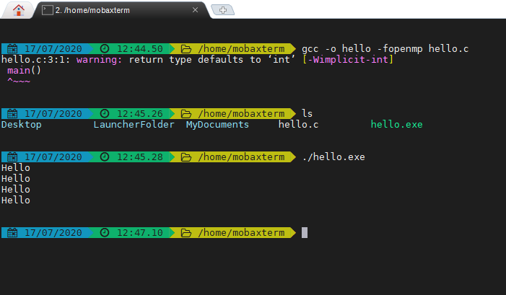
Sample Screen Shot of MobaXTerm

Slide 16
Write a openmp program that should have four threads and each thread should print your name

Slide 17
Work Sharing Construct

Slide 18
for directive
Specifies that the iterations of the loop immediately following it must be executed in parallel by the team.
This assumes a parallel region has already been initiated, otherwise it executes in serial on a single processor.

Slide 19
Continued…
#pragma omp parallel for [clause ...]
schedule (type [,chunk])
ordered private (list)
firstprivate (list)
lastprivate (list)
shared (list)
reduction (operator: list)
collapse (n)
nowait
for_loop

Slide 20
Example: for construct
#include <omp.h>
main ()
{ (Sum of all sum[i]); (min:s1)
int a[10],b[10],
int I, sum=0;
/* Scan values for a & b */
#pragma omp parallel
{
#pragma omp for private(sum) reduction(+:sum)
for (i=0; i < 10; i++)
{
sum = a[i] + b[i];
printf(“CPU:%d\tThread:%d\tValue:%d\n”,sched_getcpu(),omp_get_thread_num(), sum[i]);
}
}
Sum(thread 0) sum (thread 1)…
Sum=sum
/* end of parallel section */ }pf (sum) :
}

Slide 21
One thread→+
2 thread → -
3 thread →

Slide 22
Section Directive
The SECTIONS directive is a non-iterative work-sharing construct
It specifies that the enclosed section(s) of code are to be divided among the threads in the team.

Slide 23
Syntax
#pragma omp sections [clause ...]
private (list)
firstprivate (list)
lastprivate (list)
reduction (operator: list)
nowait
{
#pragma omp section
structured_block
#pragma omp section
structured_block
}

Slide 24
Sample problem 1
int sum[10];
int a[10];
int b[10];
int i;
for (i=0;i<10;i++)
{
a[i]=i;
b[i]=i;
}
#pragma omp parallel for
for (i = 0; i < 9; i++)
{ sum[i]=a[i]+b[i];
printf(“%d”,sum[i])
}

Slide 25
Example
#include <omp.h>
#define N 1000
main ()
{ int i;
float a[N], b[N], c[N], d[N];
/* Some initializations */
for (i=0; i < N; i++)
{
a[i] = i * 1.5;
b[i] = i + 22.35;
}
#pragma omp parallel sections
{
#pragma omp section
for (i=0; i < N; i++) c[i] = a[i] + b[i];
#pragma omp section
for (i=0; i < N; i++) d[i] = a[i] * b[i];
#pragma omp section
for (i=0; i < N; i++) e[i] = a[i] - b[i];
} /* end of sections */
} /* end of parallel section */
}

Slide 26
Thread1 → a[i]+b[i] (a[o]+b[0]…)
Thread 2 → a[i]*b[i] (a[0]*b[0]
Thread 3→a[i]-b[i]

Slide 27
Single Directive
The SINGLE directive specifies that the enclosed code is to be executed by only one thread in the team.
May be useful when dealing with sections of code that are not thread safe (such as I/O)

Slide 28
Syntax
#pragma omp single [clause ...]
private (list)
firstprivate (list)
nowait
structured_block

Slide 29
Combined work sharing Constructs
# pragma omp parallel for
shared (list) private (list)
schedule(static,chunk)

Slide 30
Example: Parallel for
#include <omp.h>
#define N 1000
#define CHUNKSIZE 100
main ()
{
int i, chunk;
float a[N], b[N], c[N];
/* Some initializations */
for (i=0; i < N; i++)
a[i] = b[i] = i * 1.0;
chunk = CHUNKSIZE;
#pragma omp parallel for
shared(a,b,c,chunk) private(i)
schedule(static,chunk)
for (i=0; i < n; i++) c[i] = a[i] + b[i];
}

Slide 31
Task construct
Defines an explicit task that can be executed by the encountering thread, or deffered for execution by any other thread in the team.
Syntax:
  # pragma omp task […]
    structured block

Slide 32
Synchronization constructs
Critical
  # pragma omp critical [name]
  structured block
Master
  #pragma omp master
    Structured block
    Executed only by the master

Slide 33
Continued…
Example
#include <omp.h>
main()
{
int x;
x = 0;
#pragma omp parallel shared(x) {
#pragma omp critical
x = x + 1;
}
/* end of parallel section */
}

Slide 34
Sieve of Eratosthnese
A method to find prime numbers less than or equal to ‘n’
  Begins with a list of natural numbers
  Removes composite numbers from the list
  Terminates after multiples of the largest prime less than or equal to SQRT(n)

Slide 35
Programming for multi-core
Programmers must use threads or processes
Spread the workload across multiple cores
Write parallel algorithms
OS will map threads/processes to cores

Slide 36
Thread safety very important
Pre-emptive context switching:
context switch can happen AT ANY TIME
True concurrency, not just uniprocessor time-slicing
Concurrency bugs exposed much faster with multi-core

Slide 37
Assigning threads to the cores
Each thread/process has an affinity mask
Affinity mask specifies what cores the thread is allowed to run on
Different threads can have different masks
Affinities are inherited across fork()

Slide 38
Affinity masks are bit vectors
Example: 4-way multi-core, without SMT
1
1
0
1
core 3
core 2
core 1
core 0
Process/thread is allowed to run on
cores 0,2,3, but not on core 1

Slide 39
Affinity masks when multi-core and SMT combined
Separate bits for each simultaneous thread
Example: 4-way multi-core, 2 threads per core
1
1
0
0
1
0
1
1
core 3
core 2
core 1
core 0
thread
1
thread
0
thread
1
thread
0
thread
1
thread
0
thread
1
thread
0
Core 2 can’t run the process
Core 1 can only use one simultaneous thread

Slide 40
Default Affinities
Default affinity mask is all 1s:
all threads can run on all processors
Then, the OS scheduler decides what threads run on what core
OS scheduler detects skewed workloads, migrating threads to less busy processors

